Slide 1



HACK MATRIX HACKATHON
PROJECT TITLE : Smart Resume-Job Matcher with Skill Gap Analyzer
TEAM NAME : Trinity
TEAM MEMBERS :
Unnati Sharma 24BCE11097
Anvi 24BCE10170
Somya NEEMA 24BCE10486

Slide 2

PROBLEM STATEMENT
Describe the problem clearly .
In today’s competitive job market, many candidates—especially freshers—struggle to understand how well their resume matches a job description. They often apply without knowing whether they meet the required skills or expectations, leading to frequent rejections.
Who is affected by this problem .
College students and freshers entering the job market
Job seekers with limited industry guidance
Individuals applying to multiple roles without proper feedback
Why this problem is important
High number of job rejections due to poor resume alignment
Lack of clear feedback on what is missing or incorrect
Wastage of time and effort in applying blindly
Reduces confidence and slows career growth

Slide 3
EXISTING SOLUTIONS AND GAPS
List of existing Solutions (if any)
Applicant Tracking Systems (ATS) used by companies
Online resume scanners (like Resume Worded, Jobscan)
AI tools such as ChatGPT
Professional resume review services
Explain the gap your project will address
Our project focuses on bridging this gap by:
Providing clear reasons for mismatch, not just scores
Giving actionable suggestions to improve the resume
Offering a skill gap roadmap for users
Designing a simple and beginner-friendly interface
Mention their Limitations
Provide only a match score without detailed explanation
Do not clearly explain why a resume is rejected
Lack of personalized improvement suggestions
Not specifically designed for freshers or beginners
Some tools are paid or complex to use

Slide 4
PROPOSED SOLUTION
Explain your solution clearly
Our solution is a smart Resume-Job Matcher that compares a user’s resume with a job description to evaluate how well they match.
It analyzes skills, projects, and experience, then provides a match score along with clear feedback.
The system also suggests improvements and highlights missing skills, making it especially helpful for freshers.
List key features
Match score with percentage
Detailed score breakdown (skills, projects, experience)
Identification of missing skills
Resume improvement suggestions
Simple, fresher-friendly feedback
Explain how it solves the problem
Helps users understand their job readiness before applying
Provides clear reasons for low match instead of just a score
Guides users on how to improve their resume

Slide 5
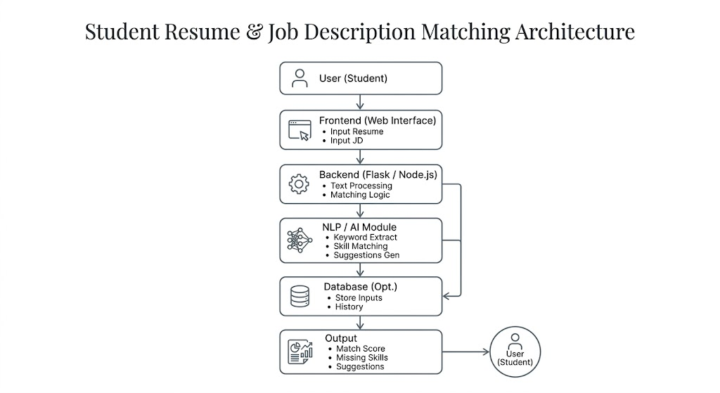
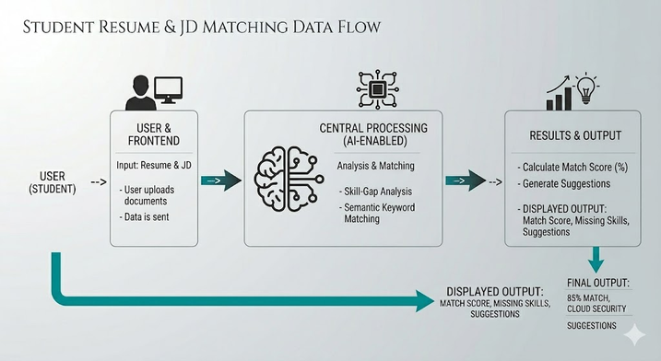
SYSTEM ARCHITECTURE
Mention main components (Frontend, Backend, Database, APIs)
Frontend Technologies
HTML, CSS, JavaScript / React
Chosen for creating a simple, responsive, and user-friendly interface
Backend Technologies
Python (Flask) / Node.js
Used to handle logic, process data, and perform resume-job matching
Database
Firebase / No Database (optional)
Used to store user inputs and results if needed
Tools & APIs Used
NLP Libraries (NLTK / spaCy)
Used for keyword extraction and text analysis
AI APIs (e.g., OpenAI API)
Used to generate smart suggestions and explanations
Code Editor (VS Code)
Used for efficient development and debugging
Include architecture diagram
Explain data flow briefly

Slide 6
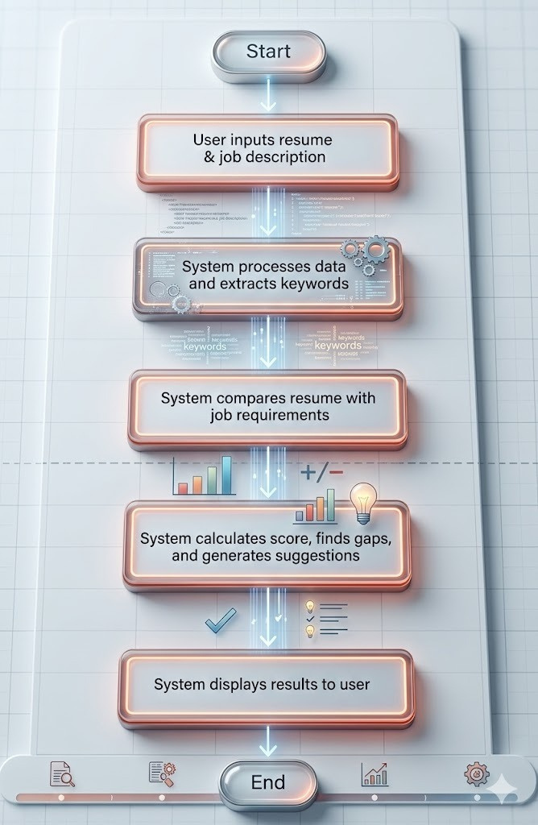
FLOWCHART / WORKING PROCESS
Show step-by-step working
Include user flow or system flow

Slide 7
TECH STACK
Frontend technologies
Database
HTML5 – Structure of the web app
CSS3 – Design and layout
JavaScript – Interactivity
React (optional) – Dynamic UI
Firebase / MongoDB – Store user data
Stores:
Resume inputs
Job descriptions
Analysis results
Backend technologies
Python / Node.js – Backend logic
Flask / Express.js – API handling
Natural Language Processing – Resume analysis
Firebase (optional) – Data storage

Slide 8
IMPLEMENTATION PLAN
Step-by-step development plan
Modules or features to be built
Design Interface
Create input page for resume & job description using HTML5 & CSS3
Build Frontend
Add interactivity with JavaScript
Setup Backend
Use Flask / Express.js
Implement Matching Logic
Compare resume & job description using
Natural Language Processing
Generate Output
Show match score, missing skills, and suggestions
Integrate & Test
Connect frontend + backend and test the system
User Input Module
Enter resume & job description
Text Processing Module
Clean and analyze text using Natural Language Processing
Matching Module
Compare skills and keywords
Score Generation Module
Calculate match percentage
Gap Analysis Module
Identify missing skills
Suggestion Module
Provide improvement tips
Result Display Module
Show score, feedback, and roadmap

Slide 9
EXPECTED OUTCOME / IMPACT
Expected results of the project
Accurate resume-job match score
Identification of missing skills
Personalized improvement suggestions
Real-world impact
Reduces job rejection rates
Improves employability of freshers
Supports better career decision-making
Benefits to users
Helps users improve their resumes
Saves time by providing clear feedback
Increases chances of job selection

Slide 10
FUTURE SCOPE AND CONCLUSION
Future improvements
Support for PDF/DOC resume uploads
Integration with job portals (LinkedIn, etc.)
Advanced AI-based suggestions
Multi-language support
Final summary
This project helps users understand how well their resume matches a job and provides clear guidance to improve it, making job preparation smarter, faster, and more effective.
Scalability of the project
Can be expanded into a full career guidance platform
Can support thousands of users with cloud deployment
Can integrate additional features like job recommendations and interview prep

